Slide 1
Investigating core periphery structure for centrality resilience, prediction and representation learning
Soumya Sarkar (15CS91P01)
Advisor: Prof Animesh Mukherjee

Slide 2
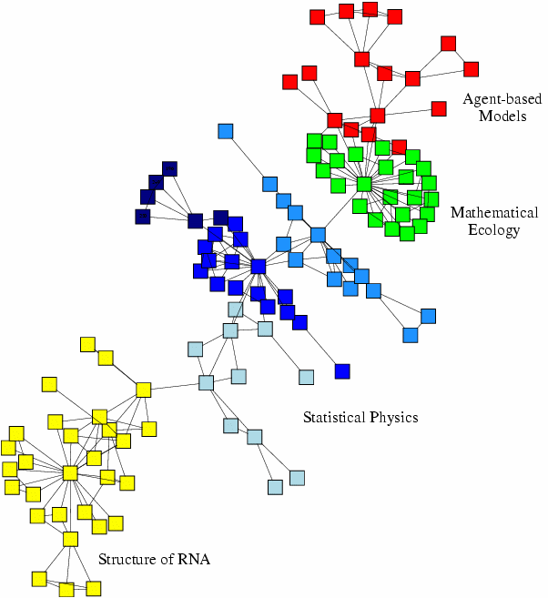
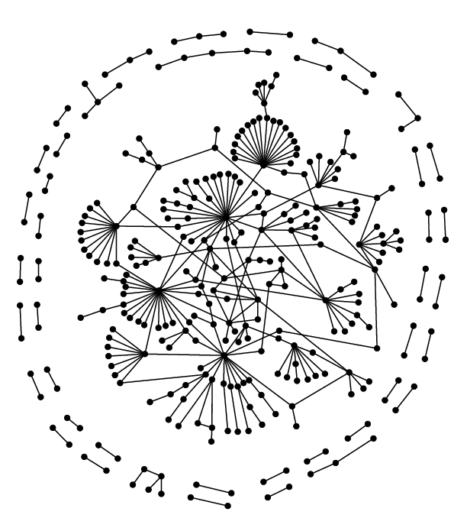
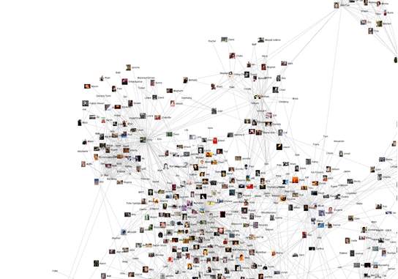
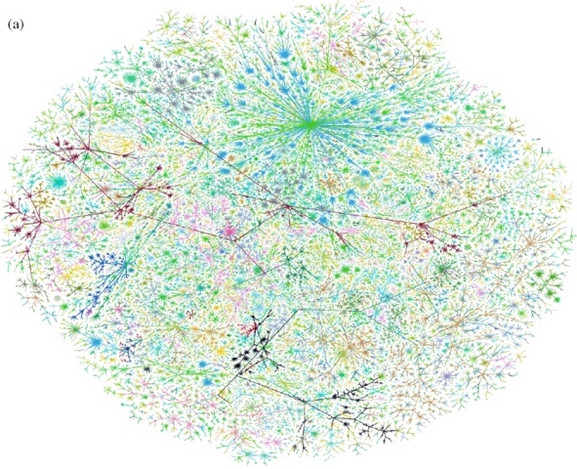
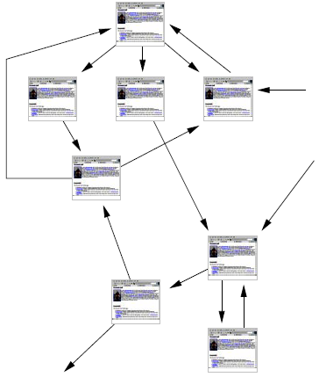
Networks are Ubiquitous
Economic networks
Biomedical networks
Social networks
Information networks: Web & citations
Internet
Networks of neurons

Slide 3

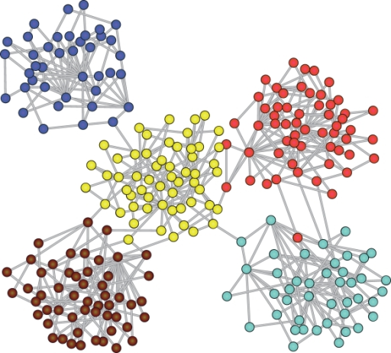

Information
diffusion
Community detection
Link Prediction

Slide 4
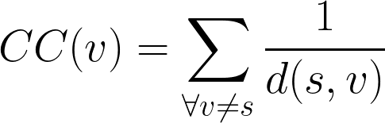
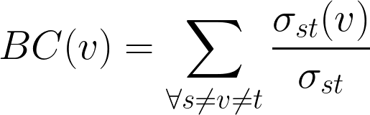
Centrality
One of the key problem in network analysis task is identifying influential nodes
Influence can be measured using centrality metrics
Closeness Centrality
d(s,v) ⟶shortest dist between s,v
Betweenness Centrality
𝜎_{st} ⟶ no. of shortest paths between s,t

Slide 5
Problems
Centrality metric is expensive to compute for large graphs
Key Research Question:
Can we use intrinsic network organization to discover central nodes ?
What organizational properties do networks have where explicit computation can be avoided ?
Can we utilize such properties in both static and dynamic graphs ?

Slide 6
Key Structure we study for our objective : Core periphery organisation

Slide 7
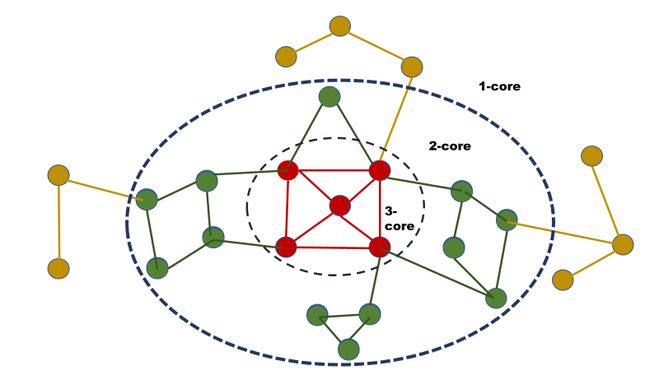
Graph degeneracy uncovered by k-core decomposition¹
Linear to the size of the graph
Scalable to large scale graphs
Fast and easy to compute
[1] Batagelj et. al. 2003

Slide 8
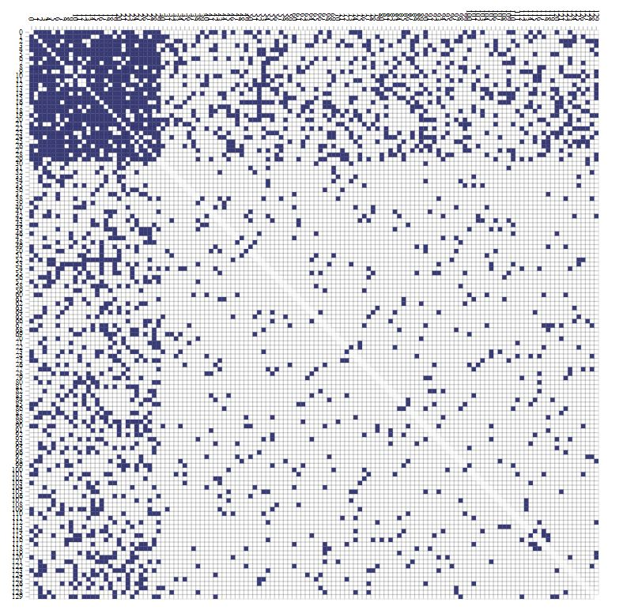
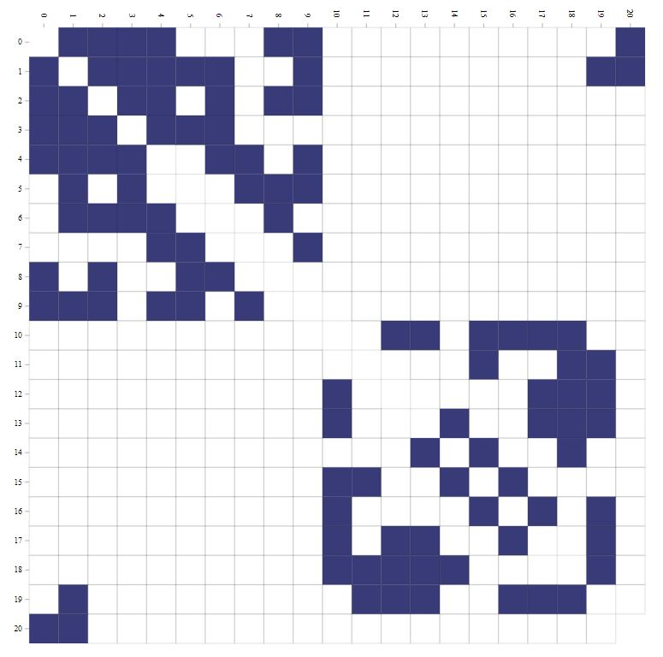
Ideal core periphery
Structure adjacency matrix
Ideal community
Structure adjacency matrix

Slide 9
Objectives of thesis
Studying Rich Centrality clubs in Networks
Identifying influential nodes in time varying networks
Network representation learning using k-core structure

Slide 10
Studying Rich Centrality clubs in Networks
CIKM 2018

Slide 11
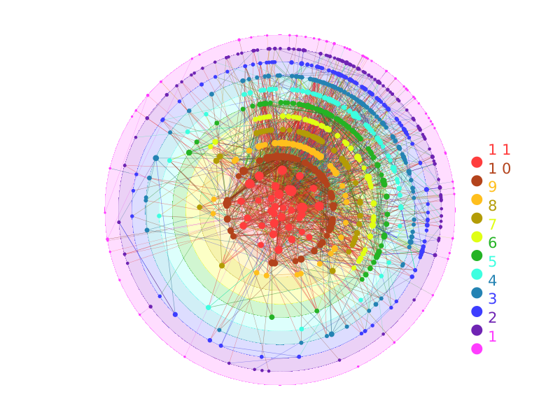
Hypothesis
Real world networks are often organised into hierarchical shells uncovered by k-core decomposition.
Since inner cores are dense by definition, members of
inner core connect pair of nodes in multiple shells.
We ask following Research Questions
RQ1: Inner most core a container for globally influential nodes ?
RQ2: How inner core nodes organized in communities ?
RQ3: What role does inner core nodes play in information propagation in the network ?

Slide 12
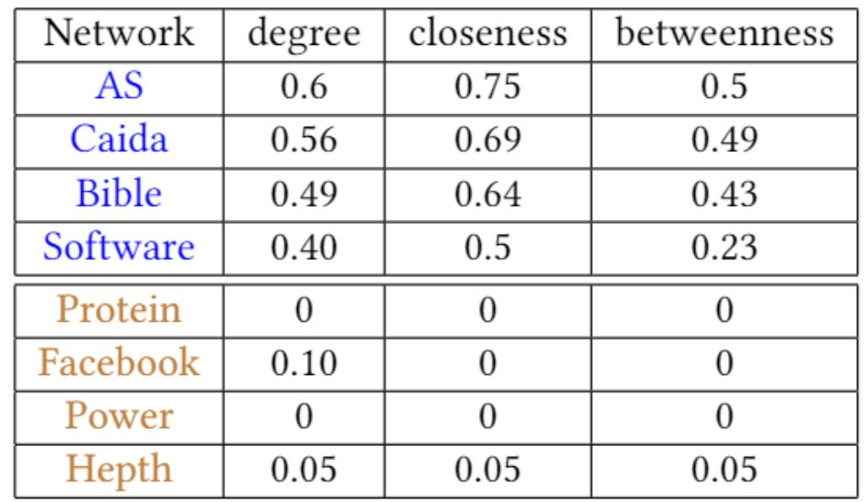
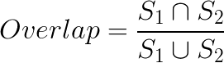
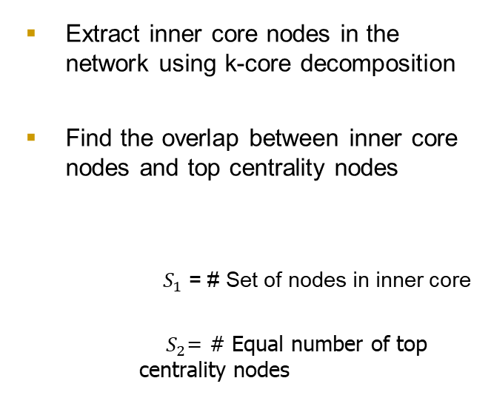
RQ1: High core → High centrality ?
Extract inner core nodes in the network using k-core decomposition
Find the overlap between inner core nodes and top centrality nodes
$S_{1}$ = # Set of nodes in inner core
$S_{2}$= # Equal number of top centrality nodes
Our intuition i.e. high core imply high centrality doesnot hold in all networks

Slide 13
RQ2: High Core in Communities
Extract communities using Louvian Method²
Order communities in order of size
Find top core nodes in communities
Our results show discriminating characteristics in Networks
[2] Blondel et. al. 2011

Slide 14
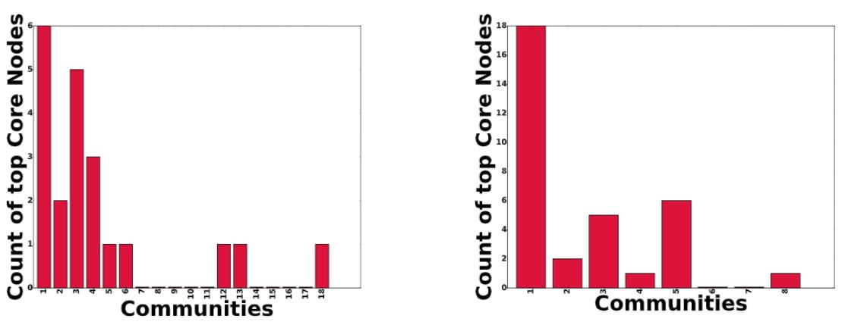
High core nodes distributed among multiple communities

Slide 15
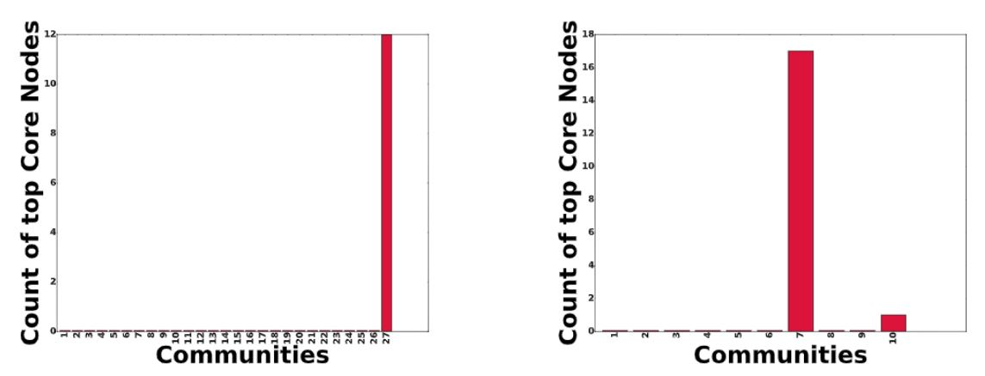
High core nodes localised in one community

Slide 16
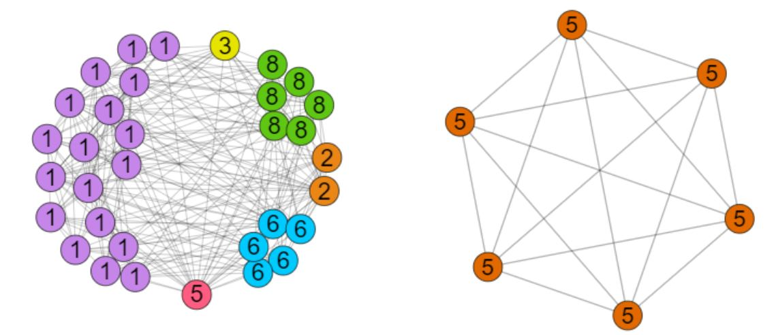
Key Takeaways
Top core nodes distributed in multiple communities
Top core nodes concentrate in single community

Slide 17
RQ3: Information through inner core
Extract communities using Louvian Method
Form meta network with
Communities and top k-core as supervertex, connections as edges
Rank nodes with respect to centrality
Original Network
Extract top core nodes using k-core
decomposition

Slide 18
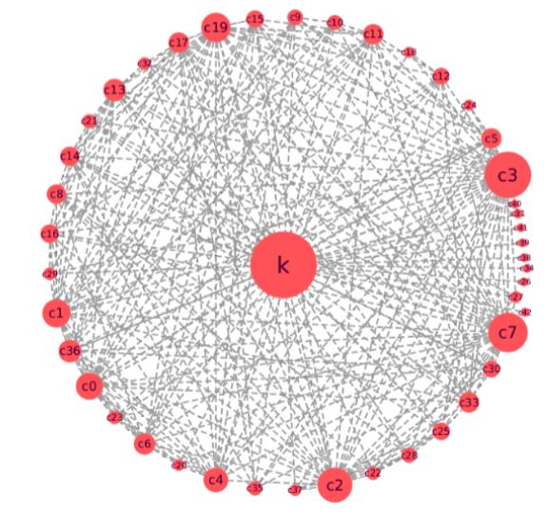
Representative example of the meta network
Node sizes are ordered by betweenness centrality value
Supervertex with max k core dominates other vertices in centrality.
Clearly a large fraction of shortest path traverse through the max k core.

Slide 19
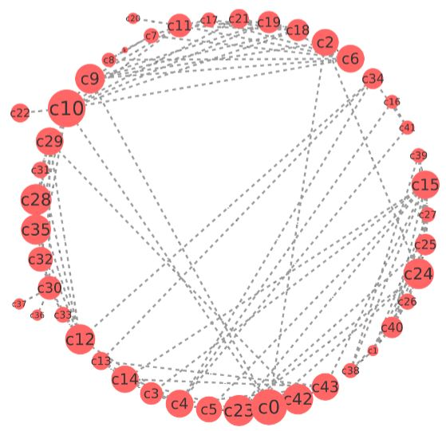
Representative example of the meta network for second class of networks
Clearly there is no supervertex with dominating centrality
Community based super vertices have comparable centrality values.

Slide 20
Key Takeaways
We coin inner most k-core subgraph which facilitate propagation of information in the network as rich centrality clubs (RCC)
Nodes part of RCC’s route majority of the information flow, i.e., they expand outwards
Influential nodes in RCC’s represent multiple communities in networks
Not all inner most core have RCC’s
Key insights from our experiments is that RCC’s act as bottleneck and expand outwards.
How do we quantify this ?

Slide 21
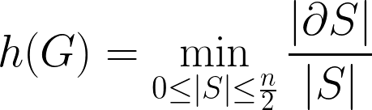
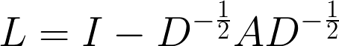
Cheeger’s constant
Cheeger’s constant approximated by second eigen value of the normalised Laplacian of the adjacency matrix.

Slide 22
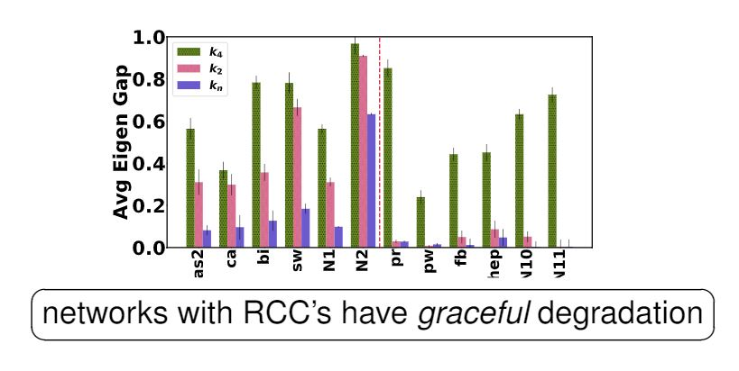

For each shell with s nodes we compute the volume of the shell V(s)
For each V(s) we compute $λ_{2}$

Slide 23
What does this imply ?

Slide 24
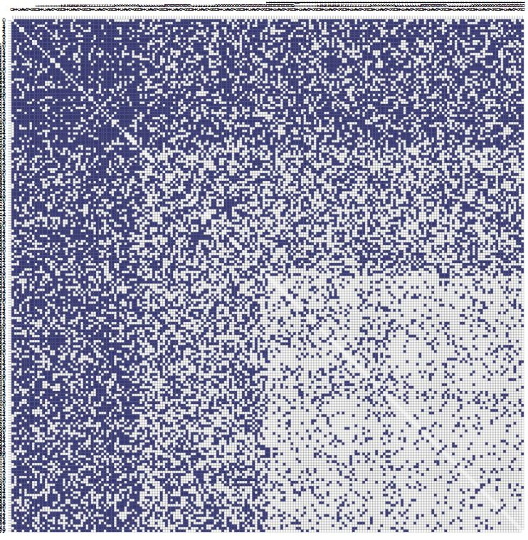
Dense innermost core
2nd inner most core
Gradually decreasing density

Slide 25
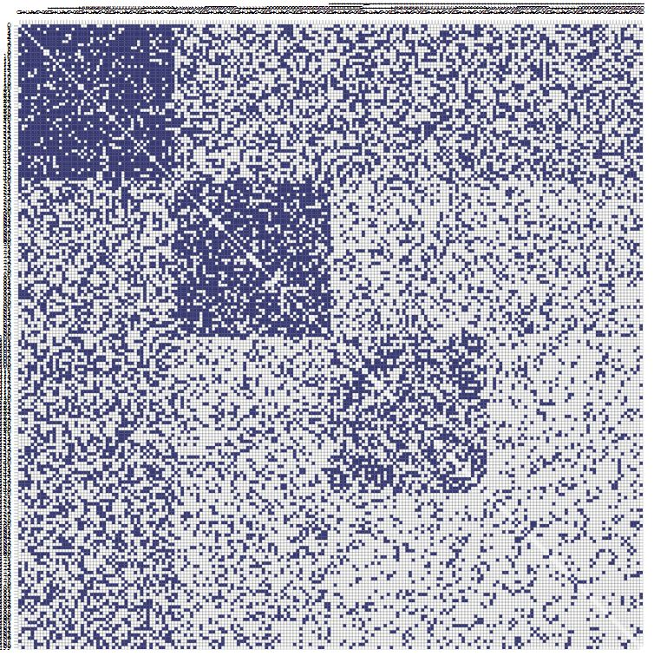
Dense Inner Core
Periphery broken into
communities
No distinct bottleneck

Slide 26
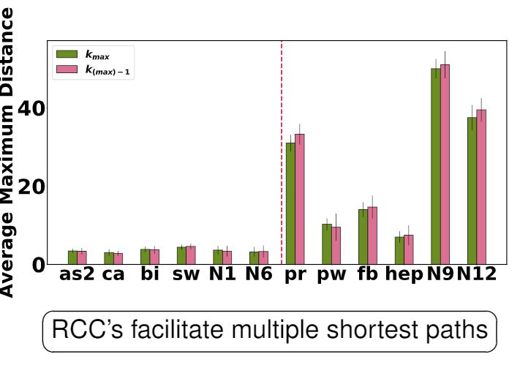
We also show a complementary experiment of expansion factor based on connectivity
For each non RCC node we calculate avg max distance with a rich club node

Slide 27
Applications
Following our exploration of the structure of networks with RCC’s, we now devise strategies to utilize their unique characteristics to solve certain tasks.
We consider two specific network functions
diffusion
robustness

Slide 28
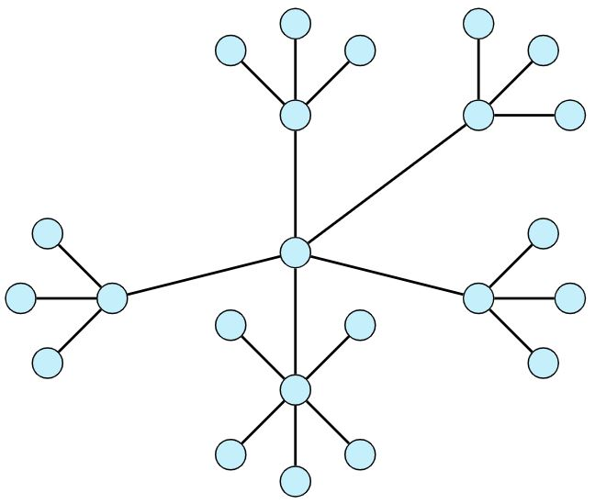
Diffusion Task
Original Network

Slide 29
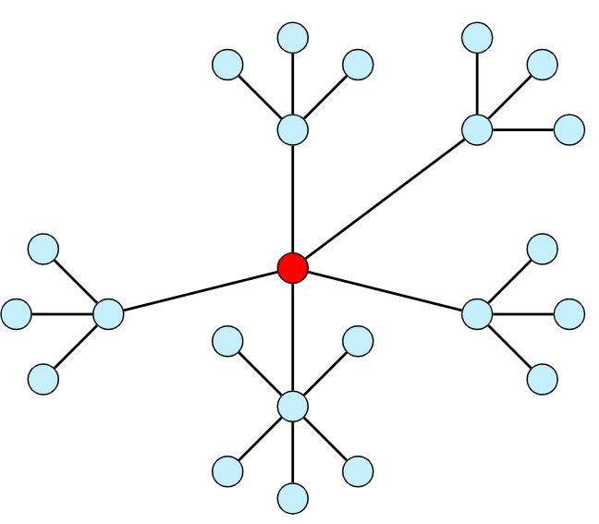
Step 1

Slide 30
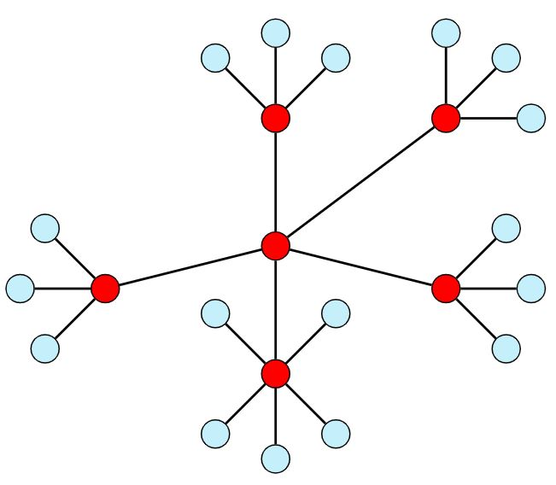
Step 2

Slide 31
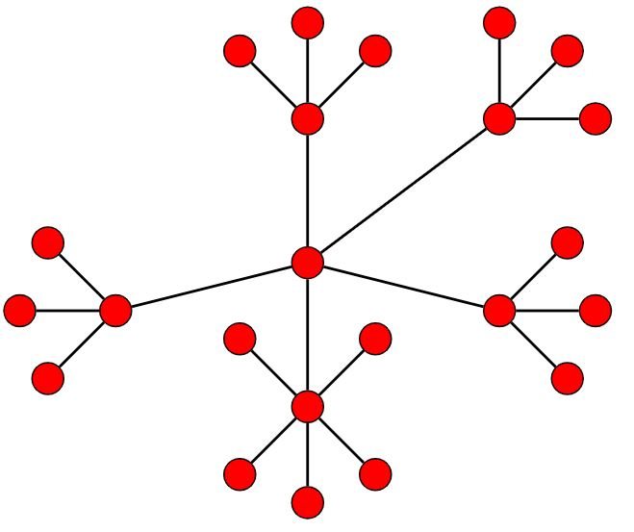
Step 3

Slide 32
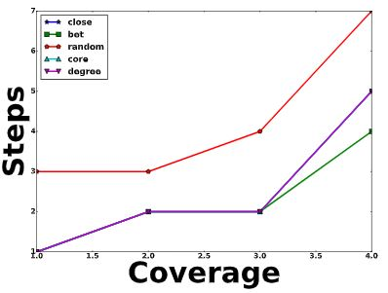
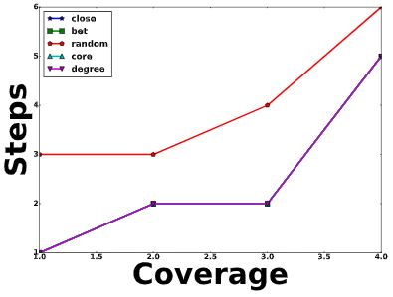
In networks with RCC, core based seed selection strategy works comparable other techniques.

Slide 33
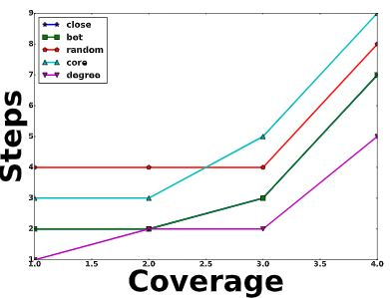
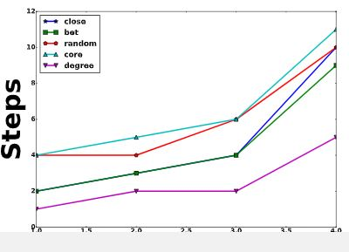
In networks without RCC, core based strategy works comparable to random selection of seed nodes.

Slide 34
Robustness Task
One of the desirable properties of a network is whether it can retain the ranking of its top-k high centrality nodes under perturbation of the network.
We have seen that RCC’s act as a bottle-neck in efficient information flow in the network.
High fraction of shortest path ⇒ redundancy.
Hence networks with RCC should be robust against minor perturbations.

Slide 35
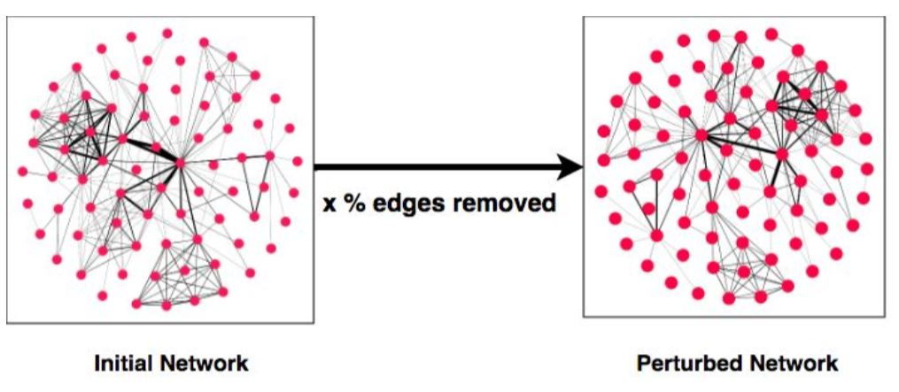
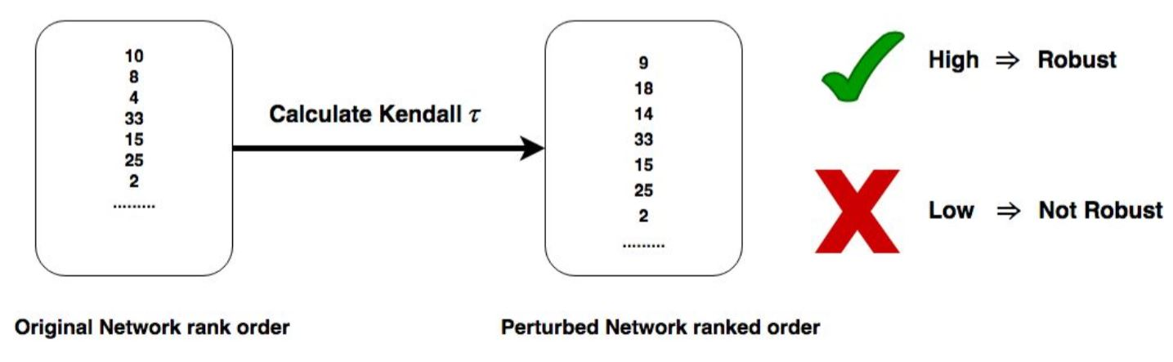

Slide 36
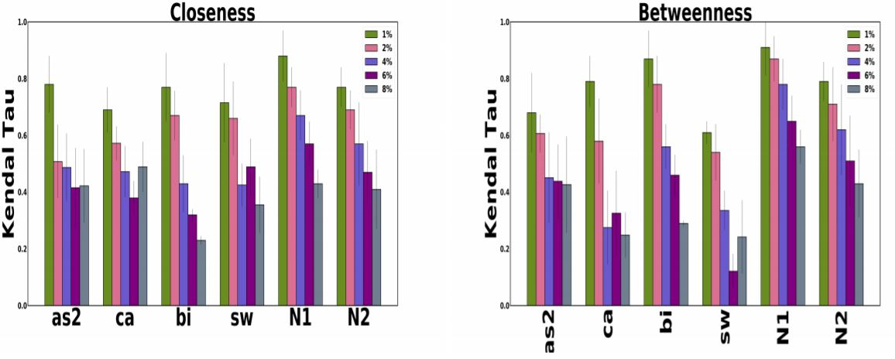

Slide 37
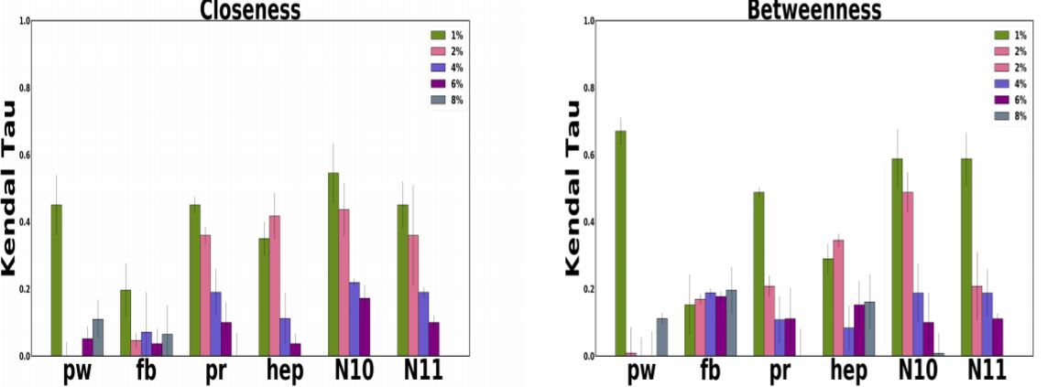

Slide 38
Scattered RCC
Our experiments show that in some networks RCC are located in the graph degeneracy
We hypothesize that RCC’s can be revealed by second order investigation of the original graph.

Slide 39
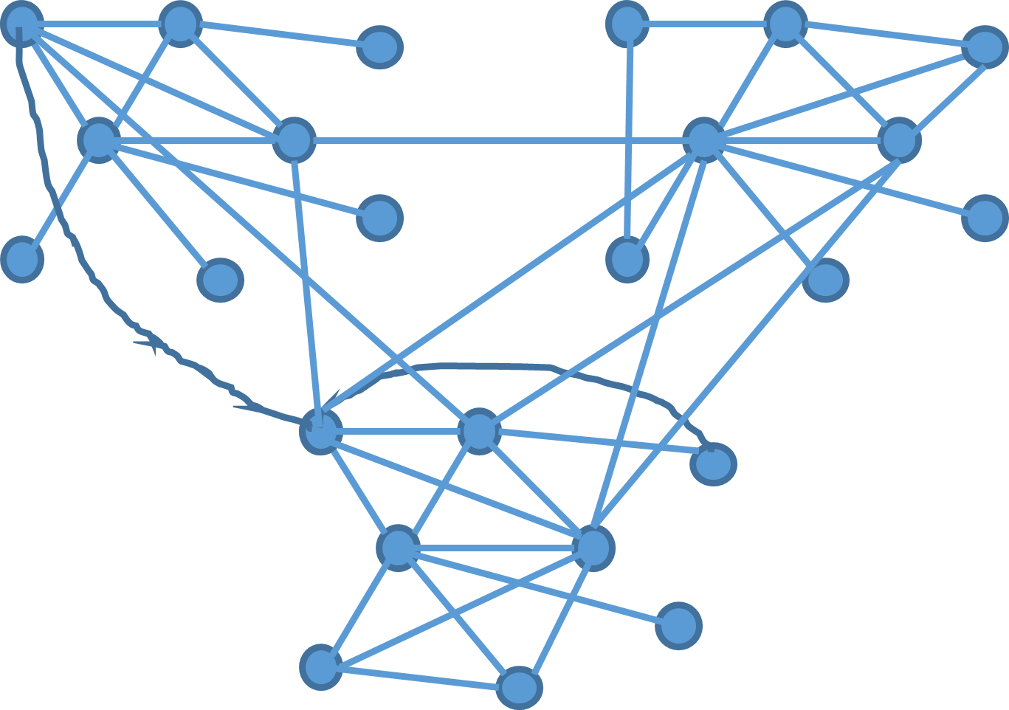
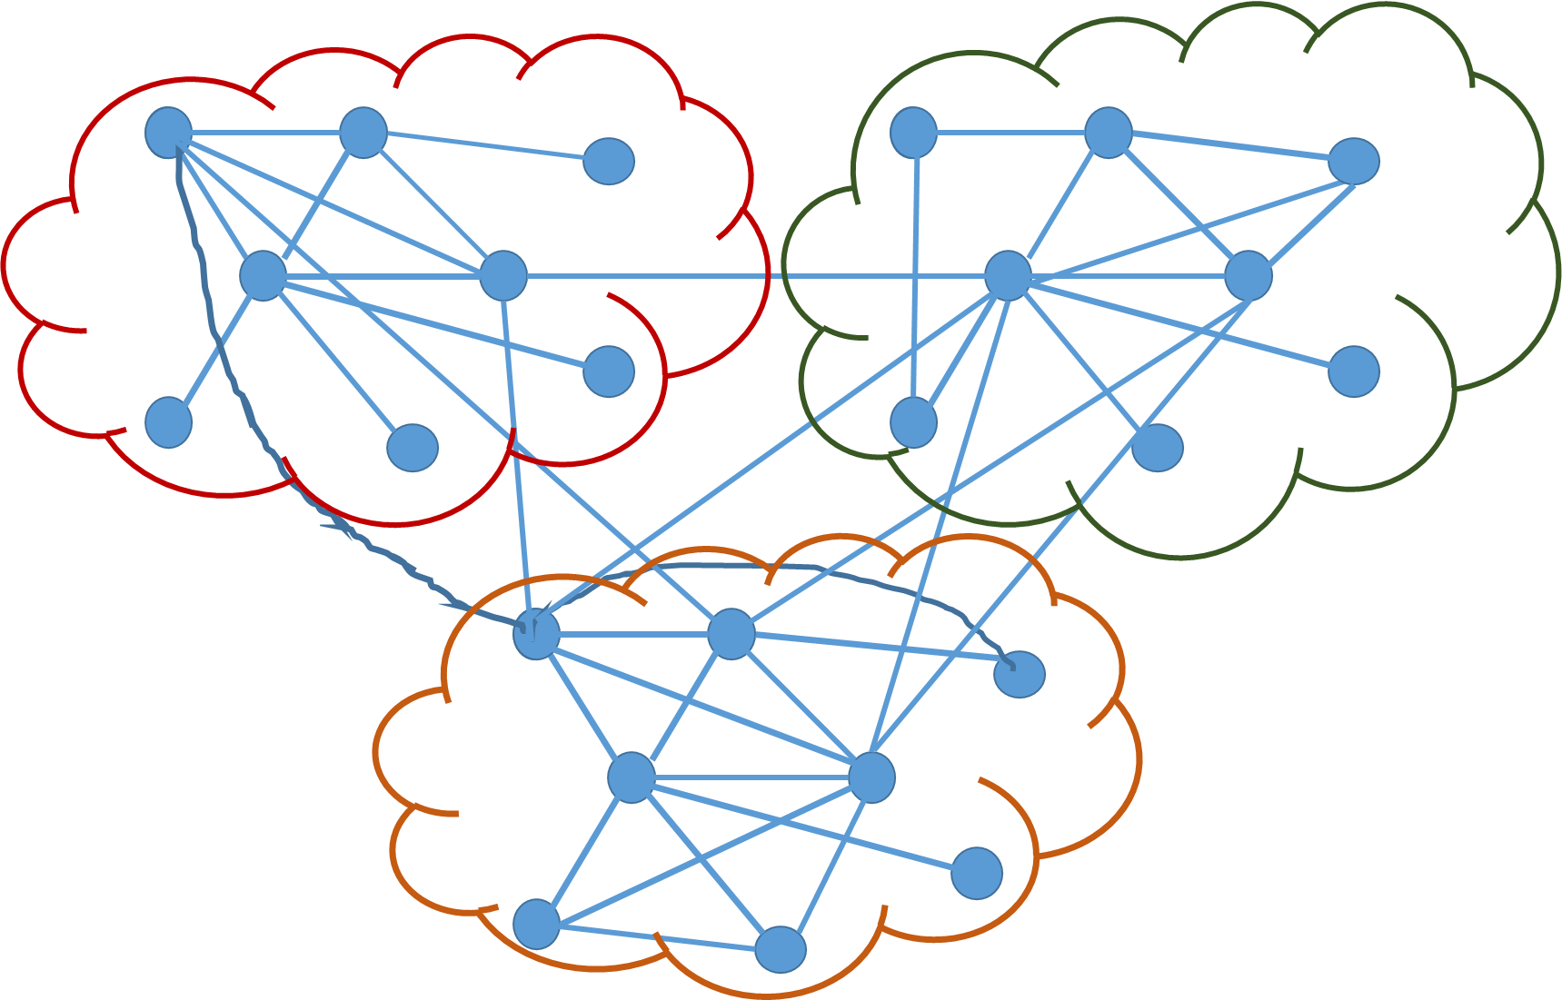
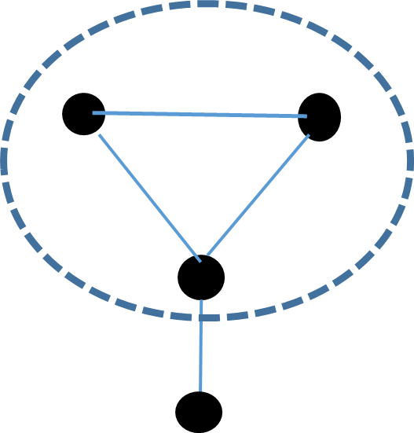
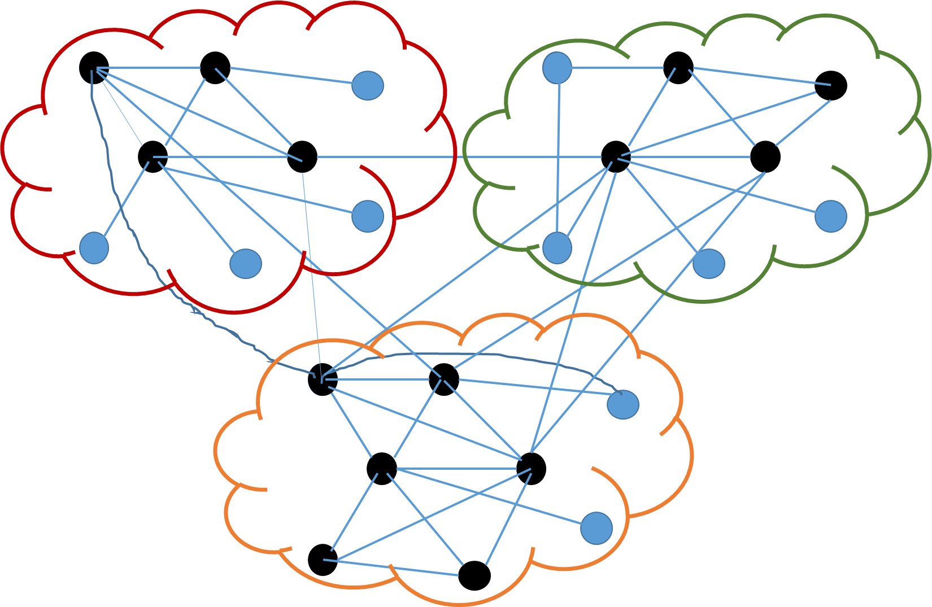
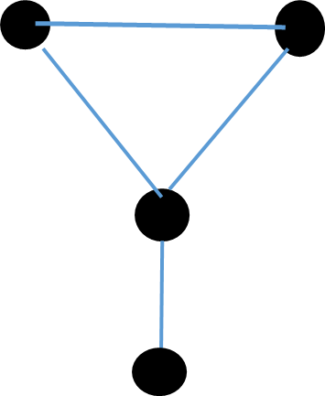
Original Network
Apply community detection
K-core detection
Meta Network
Meta Network
Apply CPM on individual clusters

Slide 40
Network | CC(% top 20) G (K_{max}) | BC(% top 20) G (K_{max}) | CC(% top 20) G’ (K_{max}) | BC(% top 20) G’ (K_{max})
as | 70 | 70 | 95 | 95
caida | 65 | 60 | 85 | 80
Bible | 65 | 60 | 85 | 80
Software | 65 | 65 | 90 | 85
hepth | 5 | 5 | 75 | 75
power | 0 | 0 | 45 | 25
protein | 0 | 0 | 70 | 65
facebook | 5 | 0 | 70 | 65
G(K_{max} ) →
Inner most core of original network
G’(K_{max} ) →
Inner most core of meta network

Slide 41
Summary of Chapter
We perform a rigorous series of experiments to show that inner most core of some networks act as rich club of path based central nodes.
We show discriminating properties of networks in terms of information diffusion and robustness
We also develop novel second order network analysis approach to discover central nodes in the network.

Slide 42
Identifying influential nodes in time varying networks
ECML PKDD 2018

Slide 43
Motivation
Centrality metric is expensive to compute for large graphs
Closeness Centrality is O(V*E) for simple undirected unweighted graphs
Betweenness Centrality is O(E*V + N^2log(N)) for simple undirected weighted graphs
Studying Rich Centrality clubs in Networks

Slide 44
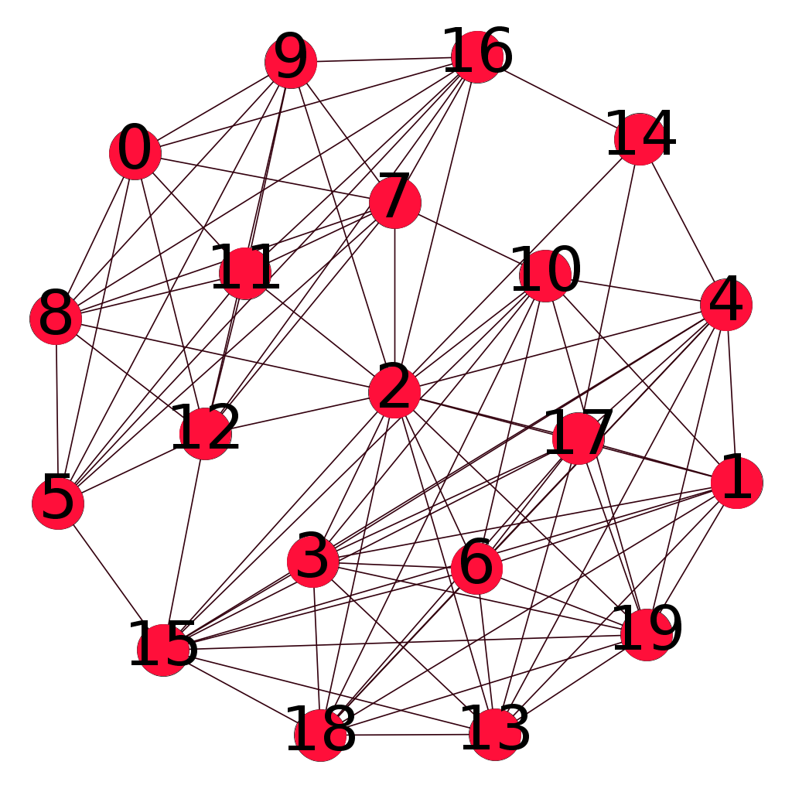
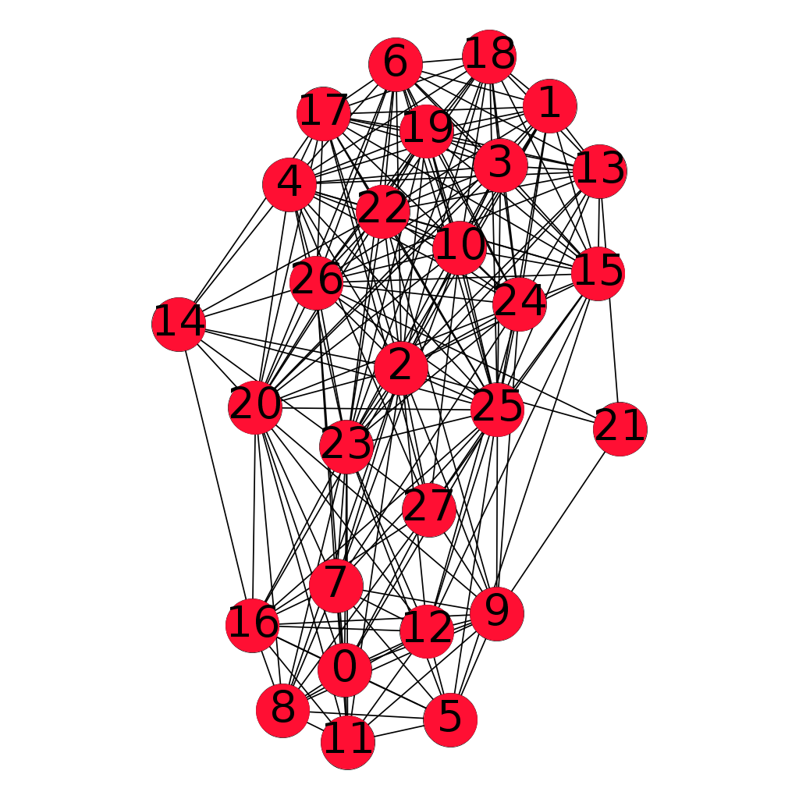
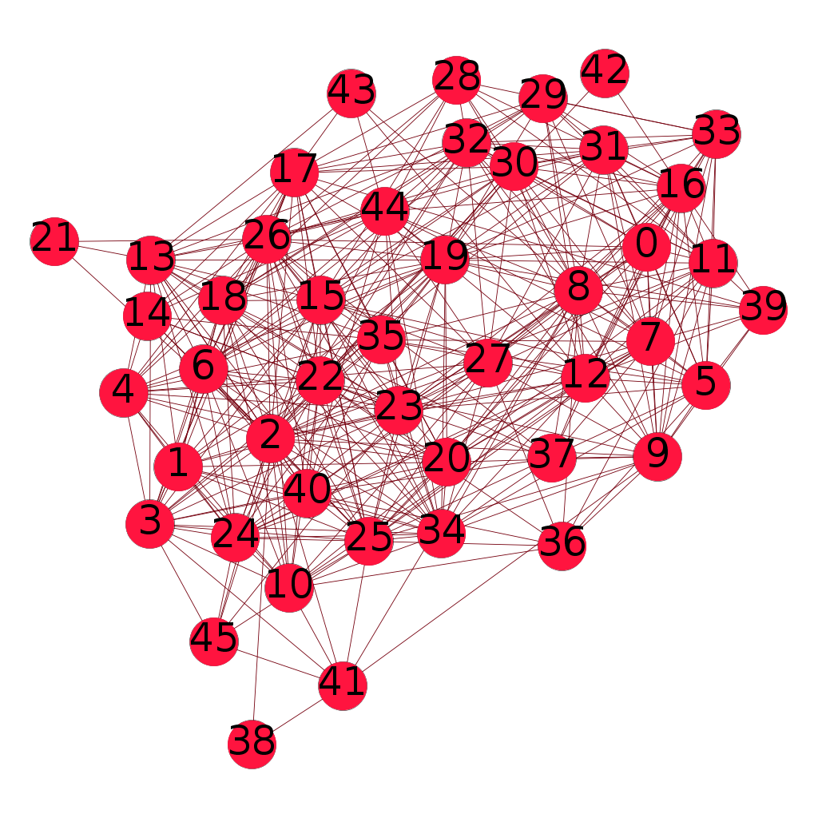
Motivation
Network
Snapshot 1
Network
Snapshot 2
Network
Snapshot 3
In temporal networks shortest path enumerations are required over multiple snapshots

Slide 45
Problem Statement
Given a series of temporal graphs where G_{(t-k)} is observed and G_{t} is unseen
G₁ ……. …G_{(t-k)}…….G_{t-1}……. G_{t} ✗
Can we identify network measures which can help us predict with higher certainty whether high central nodes in past time steps retain their importance
G₁ …. G_{(t-k)} … G_{t-1}……. G_{t} ✓
Given G_{t} has arrived can we predict id’s of top high centrality nodes ?

Slide 46
Hypothesis
We posit that if a dense group of vertices such as the inner most core exists and majority of shortest path passes through this set then
High central vertices will also be part of this set.
Based on the persistence of this core over successive time steps we can predict high central nodes in future timesteps.
How to we check if a network conforms this property ?
We provide a set of novel network measures to classify networks based on the extent to which they conform to our hypothesis.

Slide 47
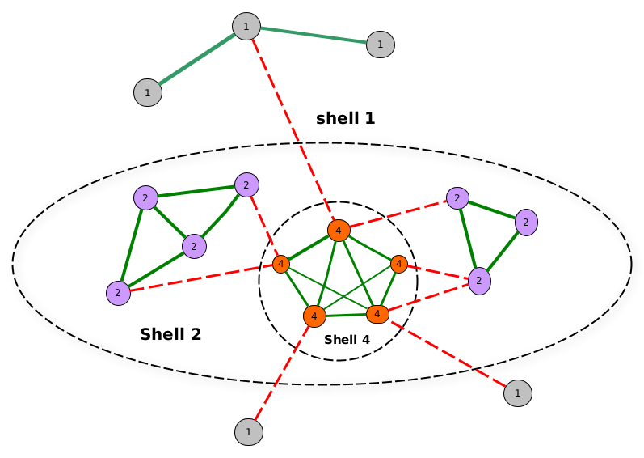
Metrics 1
Fraction of inter-edges connected to the top core (EF)
Higher value desirable

Slide 48
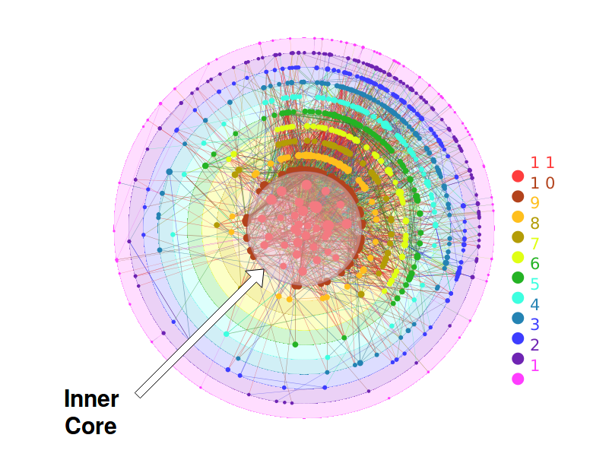
Metrics
Density of the top-core (ED)
higher desirable
Average density of the non-top cores (CD)
Lower desirable

Slide 49
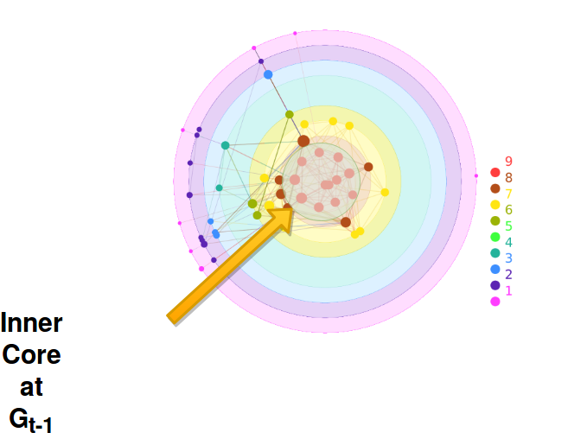
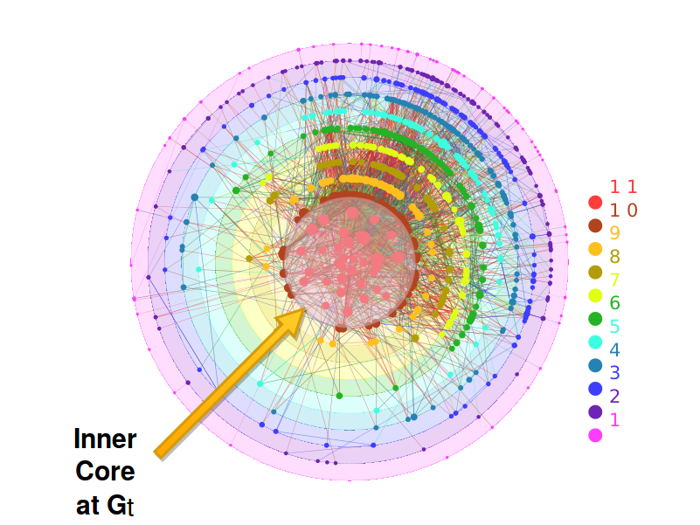
Metrics
Top-core overlap (EO)
Higher desirable

Slide 50
Distribution Computation
EF
t computations
CD t computations
Network (N1)
With t time steps
Generate
cdf for
each metric
ED t computations
CO t-1 computations

Slide 51

Datasets
8 Real world networks used in our experiments. synthetic networks generated by synthetic network generators such as Musketeer^{[3]}, Dancer^{[4]} also used.
3 A. Gutfraind et al
4 Benyahia, Oualid, et al

Slide 52
Classification Framework Overview
Cluster(G) all networks conform to desirable property
Generate CDF for each metric
for all networks
Cluster Networks based on a metric using
Hierarchical clustering
Cluster(B) all networks donot conform to desirable property

Slide 53


Slide 54
Prediction Framework
How does the classification help us ?
Our experiments show that networks where majority of heuristics is classified as G class, we predict the extent to which high central nodes retain their ranks using time series models

Slide 55
Prediction Framework
We use Auto-Regressive-Integrated-Moving-Average (ARIMA) model for prediction
On fitting ARIMA(p,d,q) model, we obtain an auto-regressive equation of the form
y_{t} = a₁y_{t-1}+...+a_{p}y_{t-p}+b₁e_{t-1}+...+b_{q}e_{t-q}+c

Slide 56

Prediction Point
Jaccard
Overlap
We calculate the overlap between top k high central nodes across consecutive time steps using Jaccard coefficient (JC).
Prediction of time t is calculated by regressing on JC between t-1 and t-w ( w = window size)
Time
Autoregressive window
For a given time step t, the original overlap value is o_{t} and the predicted value is p_{t} , we define the error in prediction error (e_{t} ) as

Slide 57

Results for ARIMA Model

Slide 58

Results for AR, MA, ARMA models

Slide 59
Predicting top central nodes
Majority
Metric in cluster(G)
?
Calculate cdf for a new temporal network from previous t-1 values
for each metric
Classify each metric using nearest centroid method
Perform explicit computations
NO
YES
G_{t} available?
YES
Return top k high degree nodes of inner core nodes
Predict overlap of the top central nodes between G_{t-1} and G_{t}
NO

Slide 60

We compare against global degree as well as existing baselines
Our Method

Slide 61
Validation
We demonstrate that the behavior of our predicted high centrality vertices is very similar to the actual high centrality vertices in a practical context.

Slide 62
Validation
Strategy I (Closeness)
Select top 10 high central nodes by actual computation, predicted nodes and random choice
Start a diffusion process with the set as seed nodes → In each step all neighbours of the seed nodes are infected
Process stops when all nodes infected.
Calculate no of steps needed

Slide 63
Validation
Strategy II (Betweenness)
Select top 10 high central nodes by actual computation, predicted nodes and random choice
Remove the set of nodes from the network
Calculate diameter

Slide 64

Results with true centrality and predicted centrality are comparable

Slide 65

Results with true centrality and random nodes are comparable

Slide 66
Summary of Chapter
In this chapter we present a classification approach based on novel heuristics
We present a time series based prediction model for identifying identities of high central nodes in temporal networks.
We validate our prediction model against explicit computations.
Our approach achieves atleast 8x improvements in computation time compared to traditional methods

Slide 67
Representation Learning using k-core structure
ASONAM 2018

Slide 68
Node Embeddings
Input
Output
Task: Find embedding of nodes to d-dimensions so that “similar” nodes in the graph have embeddings that are close together.

Slide 69

Problem Setup
Assume we have a graph G:
V is the vertex set.
A is the adjacency matrix (assume binary).
Encode nodes so that similarity in the embedding space (e.g., dot product) approximates similarity in the original network.

Slide 70
How do we train the encoder

Slide 71

probability that u and v co-occur on a random walk over the network
$$∼$$

Slide 72
Estimate probability of visiting node v on a random walk starting from node u using some random walk strategy R.
Optimize embeddings to encode these random walk statistics.

Slide 73
Run short random walks starting from each node on the graph using some strategy R.
For each node u collect N_{R}(u), the multiset* of nodes visited on random walks starting from u.
Optimize embeddings to according to:

Slide 74
Optimize embeddings to maximize likelihood of random walk co-occurrences.
Parameterize P(v | z_{u}) using softmax:
We make this computation scalable using negative sampling

Slide 75



Core based Random Walker
Same distance to $u$
s₂
s₃
w
Farther from $u$
u
s₁
Closer to $u$
We use a biased 2nd-order random walks to explore network neighborhoods
Given the walker is at node w starting from node u, decision needs to be taken regarding next hop

Slide 76






Core based Random Walker
s₂
$$1$$
s₃
$p, q,1$ are unnormalized probabilities
w
$$q$$
u
s₁
$$p$$
p $=\frac{1}{λ∗\left|\left(c\left(w\right) −c\left(S_{1}\right)\right)+1\right|∗D}$
q $=\frac{1}{γ∗\left|\left(c\left(w\right) −c\left(S_{3}\right)\right)+1\right|∗D}$
C(u) → core number of u
D, $λ$, $γ$ parameters of the model

Slide 77


Core based Random Walker
s₂
$$1$$
C(u) → core number of u
D, $λ$, $γ$ parameters of the model
s₃
$p, q,1$ are unnormalized probabilities
w
$$q$$
u
s₁
$$p$$
p $=\frac{1}{λ∗\left|\left(c\left(w\right) −c\left(S_{1}\right)\right)+1\right|∗D}$
q $=\frac{1}{γ∗\left|\left(c\left(w\right) −c\left(S_{3}\right)\right)+1\right|∗D}$
λ determines probability to remain in vicinity of u
γ determines probability to explore further from u
Each parameter further weighted by penalised core distance

Slide 78

Metrics
Closeness: Sum of average cosine-similarity between each core-centroid and the nodes of that core. To normalize, divide by number of cores.
Separability: Average distance between all pairs of core-centroids.

Slide 79


Embedding comparison

Slide 80



Word Similarity Task
Given Word
$$a,b∈R^{d}$$
Calculate Similarity
Cosine$Sim\left(a,b\right)=\frac{a.b}{\left|\left|a\right|\right|.\left|\left|b\right|\right|}$
Obtain Human Judgement score for $a,b$
CosineSim / Human Judgement bases Ranking
(a1,b1) (a1,b1)
(a2,b2) (a3,b3)
….
Compute Spearman Rank Corelation

Slide 81

Word Association networks
Network | Nodes | Edges
USF | 10590 | 63788
SWOW | 39,026 | 400622

Slide 82
Gold standard word pairs
SimLex999 snapshot:
WordSim353 snapshot:
MTurk snapshot:
old, new, 1.58
smart, intelligent, 9.2
hard, difficult, 8.77
happy, cheerful, 9.55
hard, easy, 0.95
short, long, 1.23
tiger, cat, 7.35
book, paper, 7.46
computer, keyboard, 7.62
computer, internet, 7.58
plane, car, 5.77
train, car, 6.31
access, gateway, 3.792
account, explanation, 2
account, invoice, 3.75
account, statement, 3.682
acoustic, remedy, 1.227
acrylic, cloth, 2.739

Slide 83
Evaluation method
Gold standards consist of a list of pair of words and corresponding similarity score.
We calculate our score for the word pair by calculating the dot product of the corresponding word-vectors.
We calculate Spearman’s rank correlation between them and report the values.

Slide 84

Results
SWOW Dataset Results

Slide 85


PCA transformed
Node2vec
core2vec

Slide 86
Graph Neural Network(GCN) Based Influential Node Prediction

Slide 87
GCN Overview
Generate node embeddings based on local neighborhoods
Leskovec et. al.

Slide 88
Aggregation Technique
Node representation at k^{th} layer → Weighted aggregation of (k-1)^{th} layer

Slide 89
Application
A → R^{d}
Use Embeddings
In Downstream Prediction
Task
Possible to perform end to end training

Slide 90
Semi supervised Approach
Our previous experiments show evidence that inner core nodes in the network act as proxy for influential nodes.
Inner core nodes can be used as positive labels in influence prediction task
Similarly outer core nodes can be assigned negative labels

Slide 91

Original Network

Slide 92

K-core identification on original network

Slide 93

Node labelling process

Slide 94

Top 3 nodes with positive predictions in terms of SoftMax probabilities

Slide 95

Core Based Masking
where
We introduce masking to remove high core distant edges
Where

Slide 96
Results
Network | GCN (CC) | GCN(BC) | Masked GCN (CC) | Masked GCN (BC)
Caida | 0.24 | 0.63 | 0.8 | 0.88
Protein | 0.46 | 0.64 | 0.84 | 0.89
Hepth | 0.24 | 0.28 | 0.7 | 0.9
Hepph | 0.5 | 0.4 | 0.6 | 0.86
Precision@20

Slide 97
Summary of Chapter
We design a novel network embedding model Core2vec with a unique exploration strategy for context nodes guided by global information.
We illustrate an application of our embedding in word analogy task, where compare similar words scored by our method against manual curated gold standard scores
A novel SSL approach for ranking influential nodes based on core-periphery structure

Slide 98
Acknowledgement
I would like to thank all collaborators especially Dr. Sanjukta Bhowmick for fruitful discussions in various stages of this thesis.
Funding agencies such as ACM IARCS, SIGIR, Microsoft, Cnerg Travel Grant for funding my travel in conferences

Slide 99
Publications from this Thesis
Soumya Sarkar, Sandipan Sikdar, Sanjukta Bhowmick, and Animesh Mukherjee. Using core-periphery structure to predict high centrality nodes in time-varying networks. Data Mining and Knowledge Discovery 32, no. 5 (2018): 1368-1396. accepted in ECML PKDD 2018 Journal Track.
Soumya Sarkar, Sanjukta Bhowmick, and Animesh Mukherjee On Rich Clubs of Path-Based Centralities in Networks In Proceedings of the 27th ACM International Conference on Information and Knowledge Management, pp. 567-576. ACM, 2018.
Soumya Sarkar, Aditya Bhagwat , Animesh Mukherjee Core2Vec: A Core-Preserving Feature Learning Framework for Networks. In 2018 IEEE/ACM International Conference on Advances in Social Networks Analysis and Mining (ASONAM), pp. 487-490. IEEE, 2018.
Soumya Sarkar, Aditya Bhagwat, and Animesh Mukherjee. A core-periphery structure based network embedding approach. (Communicated to SNAM ).

Slide 100
Publications outside Thesis
Binny Mathew, Anurag Illendula, Punyajoy Saha, Soumya Sarkar, Pawan Goyal, Animesh Mukherjee Hate begets Hate: A Temporal Study of Hate Speech. Proceedings of the ACM on Human-Computer Interaction (CSCW 2020)
Soumya Sarkar, Suhansanu Kumar, Sanjukta Bhowmick, and Animesh Mukherjee. Centrality and Community Scoring Functions in Incomplete Networks: Their Sensitivity, and Reliability. In Machine Learning Techniques for Online Social Networks, pp. 135-154. Springer, Cham, 2018
S. Sarkar, B. P. Reddy, S. Sikdar, and A. Mukherjee. StRE: Self attentive edit quality prediction in Wikipedia.In Proceedings of the 57th Annual Meeting of the Association for Computational Linguistics, pages 3962-3972, Florence, Italy, July 2019. Association for Computational Linguistics
Sandipan Sikdar, Tanmoy Chakraborty, Soumya Sarkar, Niloy Ganguly, and Animesh Mukherjee. 2018. ComPAS: Community Preserving Sampling for Streaming Graphs. In Proceedings of the 17th International Conference on Autonomous Agents and MultiAgent Systems (AAMAS ’18), 184-192.

Slide 101
Publications outside Thesis
Soumya Sarkar, Suhansanu Kumar, Sanjukta Bhowmick, and Animesh Mukherjee. Sensitivity and reliability in incomplete networks: Centrality metrics to community scoring functions. In 2016 IEEE/ACM International Conference on Advances in Social Networks Analysis and Mining (ASONAM), pp. 69-72. IEEE, 2016.
Ufimtsev Vladimir, Soumya Sarkar, Animesh Mukherjee, and Sanjukta Bhowmick. Understanding stability of noisy networks through centrality measures and local connections. In Proceedings of the 25th ACM International on Conference on Information and Knowledge Management, pp. 2347-2352. ACM, 2016.

